Slide 1


Green Pace
Security Policy Presentation
Developer: [Keri Ludemann]
Notes:
Hello everyone, I’m Keri and I’ll be providing this presentation for Green Pace about the security policy. Let’s jump in.

Slide 2

OVERVIEW: DEFENSE IN DEPTH
The security policy is meant to work with Defense in Depth strategies to prevent vulnerabilities and ensure the security of the program.
Notes:
Defense in Depth. The security policy is meant to work with Defense in Depth strategies to prevent vulnerabilities and ensure the security of the program. The Defense in Depth visual provided shows how to implement multiple layers of security that continue to protect data or assets even when one layer is bypassed.

Slide 3
THREATS MATRIX
Likely Threats that have a medium-high severity and are more likely to occur | Priority Highest level severity threats that should be addressed first
Low priority Threats that have a medium-low severity but are still possible threats | Unlikely Threats with low severity that are the least likely to occur
The threats matrix shows how threats and vulnerabilities are categorized.
Notes:
Moving on to the Threats Matrix. This matrix is meant to show an overview of how threats are categorized. The priority category tends to be for threats with high severity that need to be remediated first. The likely category is for threats that have medium to high severity and are meant to be tackled next. Low priority and unlikely are for medium to low severity threats that have less a chance of occurring but still need to be addressed.

Slide 4
10 PRINCIPLES
1. Validate Input Data
Data Type
Data Value
String Correctness
Parameters
2. Heed Compiler Warnings
String Correctness
Data Type
Parameters
Floating Point
3. Architect and Design for Security Policies
Memory Protection
Signal Handling
4. Keep it Simple
Data Type
Parameters
Floating Point
5. Default Deny
Exceptions
Assertions
SQL Injection
6. Adhere to the Principle of Least Privilege
Exceptions
Signal Handling
7. Sanitize Data Sent to Other Systems
Signal Handling
String Correctness
Memory Protection
8. Practice Defense in Depth
Memory Protection
9. Use Effective Quality Assurance Techniques
Memory Protection
SQL Injecton
Assertions
10. Threat Modeling
SQL Injection
Memory Protection
Signal Handling
Notes:
Ten core security principles. Validate input data means you ensure that the data, along with the source of the data, is valid. Heed compiler warnings. The compiler being used will provide warnings and list errors within the code that need to be fixed. Architect and design for security policies means that the architecture and design of the program should enforce security principles and standards. Keep it simple. It is better to create more simple functions and variables for a program rather than using complex designs. Default deny means you utilize exclusions rather than permissions to grant access. Adhere to the principle of least privilege tells us to provide the least amount of privileges possible to complete the work. Sanitize data sent to other systems. Only send data that is needed and remove what isn’t. Practice Defense in Depth which we mentioned earlier on in the presentation. Use effective quality assurance techniques. Employing multiple defect removal techniques through the development lifecycle can help reduce the overall percentage of defects and even eliminate vulnerabilities that can show up after deployment. Threat modeling refers to the process of anticipating threats and coming up with ways to negate them. Each Principle has at least one coding standard listed under it.

Slide 5
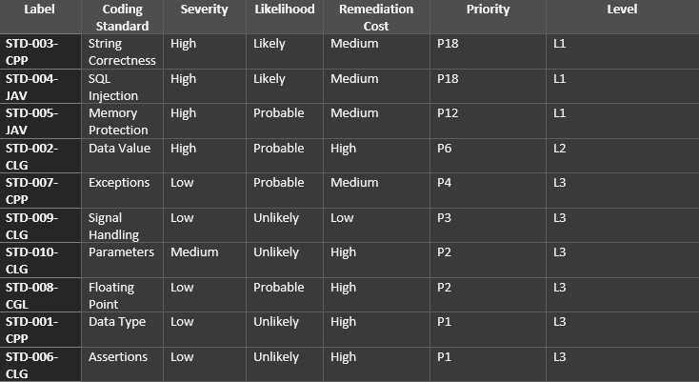
CODING STANDARDS
Notes:
Here we have a table with the coding standards put in order by priority. String correctness has the highest priority followed by SQL Injection.

Slide 6
ENCRYPTION POLICIES
Encryption at Rest – Data that is encrypted while it is stored
Encryption in Flight – Data is encrypted when being transferred
Encryption in Use – Data is when being input, processed, accessed, read, and updated
Notes:
Moving on. Next is Encryption Policies. Encryption at rest means that data is encrypted while it is stored. Who or whatever needs access will need the decryption key. Encryption in flight is when data is encrypted while it is being transferred. The recipient should have the key. Encryption in use is when data is encrypted even when being used. This includes when it is being input, processed, accessed, read, and updated.

Slide 7
TRIPLE-A POLICIES
Authentication – Can it be verified that you have access to the data?
Authorization – Do you have the necessary permissions to access this part of the system or this data?
Accounting – Who accessed what? For how long? Why was it accessed?
Notes:
Triple-A policies. Authentication is when you need to provide credentials that show you have access to a system or data. This can include usernames and passwords along with biometrics. Authorization deals with permissions. Parts of a system or certain data files may require a different level or authorization to access it. Accounting means that you or a system keeps track of what, why, and who accessed the data along with how long they accessed it for.

Slide 8
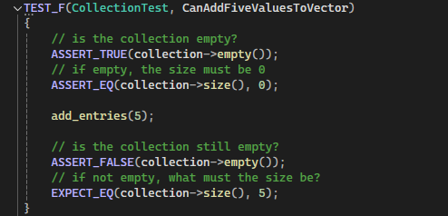
Unit Testing
The following is an example of Unit Testing that tests Assertions.
Notes:
Unit testing. The following is an example of testing Assertions. There is also a provided example of the results of performing multiple unit tests.

Slide 9
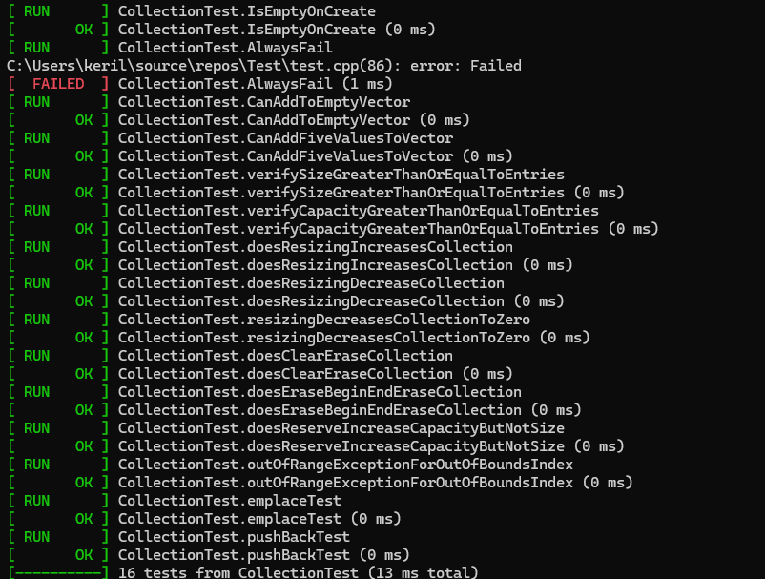
Unit Testing Continued
Here we have the results from multiple tests.

Slide 10

AUTOMATION SUMMARY
Notes:
Here we have a visual for the DevSecOps pipeline

Slide 11
TOOLS
The DevSecOps pipeline shows an overview of the steps and processes for keeping software secure
Automation is used throughout the process and there are multiple automation tools that one can choose to implement. Some examples include:
The compiler being used during the design, build, and testing stages
Aikido Security being used through the building, testing, and monitor and detect stages
Notes:
The DevSecOps pipeline shows an overview of the steps and processes for keeping software secure. Automation is used throughout the process and there are multiple automation tools that one can choose to implement. Some examples include: the compiler which would be used during the design, build, and testing stages and Aikido Security which can be used during the build, test, and monitor and detect stages.

Slide 12
RISKS AND BENEFITS
Acting Now
May take longer to deploy software
Costs after deployment can be reduced
Provides more safety for users
Produce better software
Acting Later
May require a lot of going back and forth from later stages of development to earlier stages
Costs of remediation can be high
Can take a shorter time to deploy software
Notes:
Although it is encouraged that security be included through the development lifecycle there are pros and cons to including it now and adding it later. Acting Now could mean that development is slowed so the software could take longer to deploy but remediation costs could be much lower since the software would be better set up to protect it’s users. Acting later could mean you need to repeat early stages of the lifecycle since errors are found in the later stages, remediation costs could be much higher since there will need to be fixes done after deployment, but you could possibly release software sooner.

Slide 13
RECOMMENDATIONS
Keep up with new security policies as they come out
Update training on security as needed
Update defenses as needed
Keep up to date on best coding practies
Monitor for new or updated threats and how to defend against them
Notes:
Recommendations. These are meant to accommodate for the gaps within the security policy. Security is always being improved so you should keep up-to-date with new policies that come out, provide trainings regularly when security policies are updated, always look for ways to upgrade defenses, keep up-to-date on best coding practices since that is updated regularly, and monitor for new or upgraded threats so you can act accordingly.

Slide 14
CONCLUSIONS
Employ security standards and principles
Practice Defense in Depth
Utilize Triple A
Implement automation tools
Always look for ways to improve security
Notes:
In conclusion, it’s important to ensure the security of your programs and while that can be done by employing what’s been learned through this presentation, security should always be kept up-to-date so it can better face new and upgraded threats. Look for better automation tools, keep an eye out for updates on policies and standards, ensure your Defense in depth tactics are in working order and utilize Triple-A strategies.

Slide 15
REFERENCES
Dinic, M., & Dinic, M. (2024, April 29). Understanding encryption - data at rest, in motion, in use. Jatheon Technologies Inc. https://jatheon.com/blog/data-at-rest-data-in-motion-data-in-use/
Witts, J. (2024, June 17). The top 11 DevSecOps tools for application security. Expert Insights. https://expertinsights.com/insights/the-top-devsecops-tools-for-application-security/#:~:text=Last%20updated%20on%20Jun%2017,lifecycle%2C%20from%20planning%20to%20deployment.
What is AAA Security? | Fortinet. (n.d.). Fortinet. https://www.fortinet.com/resources/cyberglossary/aaa-security
Notes:
Thank you for listening to this presentation and I hope that this will be helpful for current and future projects.

